Slide 1
Dependencies in DBMS

Slide 2
Dependency
A dependency occurs in a database when information stored in the same database table uniquely determines other information stored in the same table.

Slide 3
Functional Dependency
A functional dependency is defined as a constraint between two sets of attributes in a relation from a database.
Given a relation R, a set of attributes X in R is said to functionally determine another attribute Y, also in R, (written X → Y) if and only if each X value is associated with at most one Y value.

Slide 4
An attribute is functionally dependent on another if we can use the value of one attribute to determine the value of another.
We use the arrow symbol → to indicate a functional dependency. X → Y is read X functionally determines Y
X is the determinant set and Y is the dependent attribute. Thus, given a tuple and the values of the attributes in X, one can determine the corresponding value of the Y attribute.

Slide 5
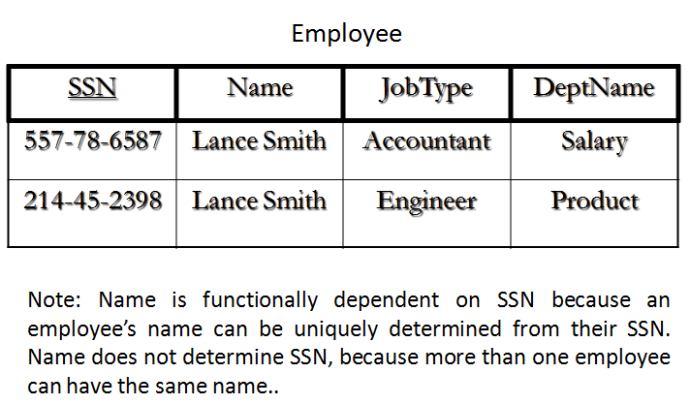
Example

Slide 6
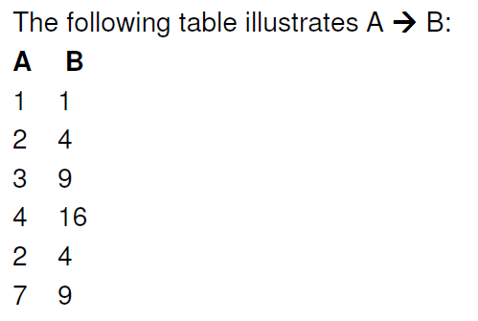
Functional Dependence (FD)

Slide 7
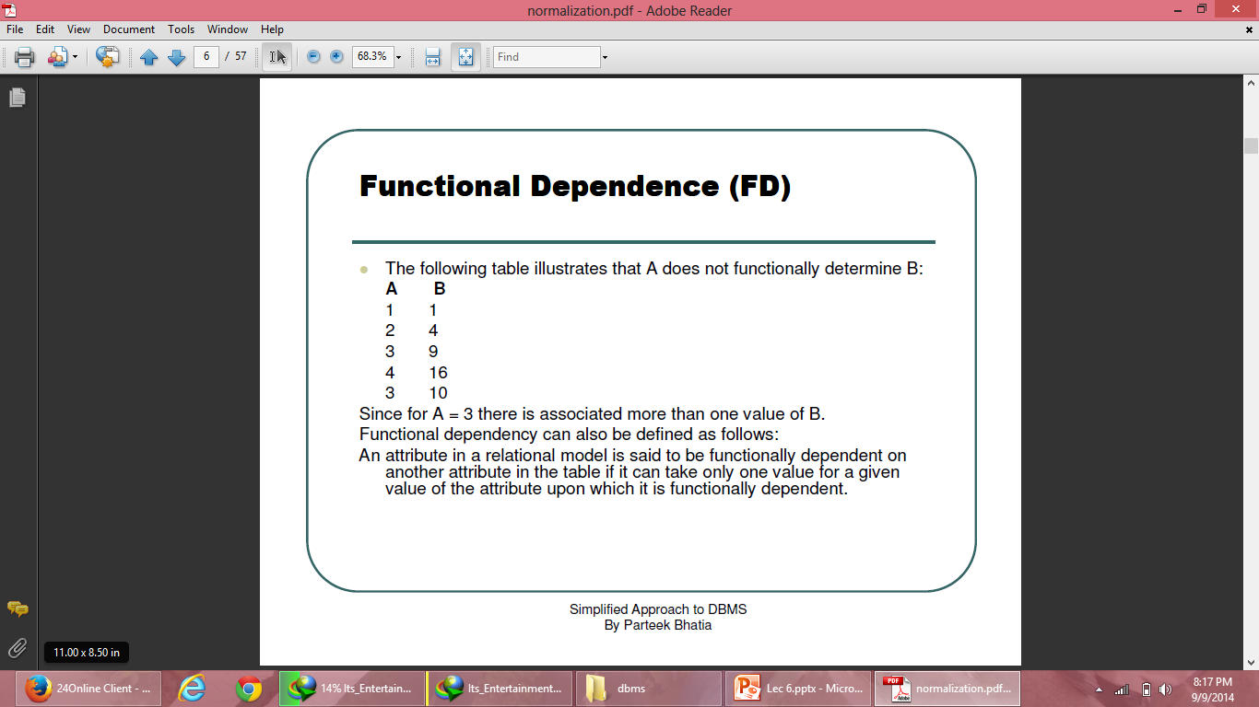
Functional Dependence (FD)

Slide 8
Partial functional dependency
In a relation R(A,B,C,D) if the key is (A,B) and
(A,B)->(C,D) holds, also (A)->(C) also holds, C is said to be partially dependent on (A,B)
Partial Functional Dependency occurs only in relation with composite keys. Partial functional dependency occurs when one or more non key attribute are depending on a part of the primary key.

Slide 9
Example
Table: Stud_id, Course_id, Stud_name, Course_Name
Where: Primary Key = Stud_id + Course_id
Then: To determine name of student we use only Stud_id, which is part of primary key.
{Stud_id} -> {Stud_Name}
Hence,Stud_name is partially dependent on Stud_id. This is called partial dependency.

Slide 10
Fully functional dependency
In R(A,B,C) if (A,B)->C holds and
neither A->C nor B->C holds then it s fully functionally dependent on (A,B).
A functional dependency X → Y is a full functional dependency if removal of any attribute A from X means that the dependency does not hold any more

Slide 11
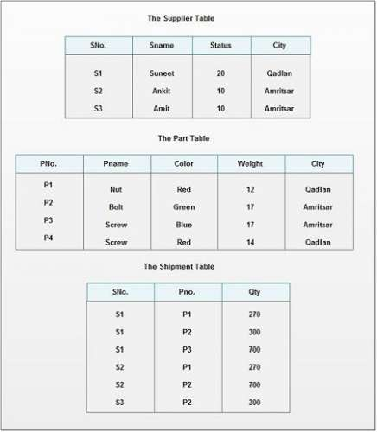

Slide 12
For example, in relation Supplier, different cities may have the same status. It may be possible that cities like Amritsar, Jalandhar may have the same status 10.
So, the City is not FD on Status.
But, the combination of Sno, Status can give only one corresponding City because “Sno” is unique. Thus,
(Sno, Status) City
It means city is FD on composite attribute (Sno, Status) however City is not fully functional dependent on this composite attribute, which is explained below:
(Sno, Status) City
X Y
Here Y is FD on X, but X has two proper subsets Sno and Status; city is FD on one proper subset of X i.e. Sno
Sno City
According to FFD definition, Y must not be FD on any proper subset of X, but here City is FD in one subset of X i.e. Sno, so City is not FFD on (Sno, Status)

Slide 13
Consider another case of SP table:
Here, Qty is FD on combination of Sno, Pno.
(Sno, Pno) Qty
X Y
Here, X has two proper subsets Sno and Pno
Qty is not FD on Sno, because one Sno can supply more than one quantity.
Qty is also not FD on Pno, because one Pno may be supplied many times by different suppliers with different or same quantities.
So, Qty is FFD on (Sno, Pno) .

Slide 14
Transitive Functional Dependency
A Transitive Functional Dependency is a functional dependency where the determinant and the determined both consists of non-key attributes.
X→ Y
X non-prime attribute
Y also non prime attribute

Slide 15
Trivial Functional Dependency
Trivial: If an FD X → Y holds where Y subset of X, then it is called a trivial FD. Trivial FDs always hold.
Non-trivial: If an FD X → Y holds where Y is not subset of X, then it is called non-trivial FD.

